Slide 1
TRANSPORTATION
SOLUTIONS

Slide 2
Overview
Additional Resources
Contact Us
Services
Local Transit
Regional Transit
Biking to SJSU

Slide 3
SmartPass Clipper
Valid on Santa Clara County Transit (VTA)
Free rides on buses (including rapid) and light rail
$3 Clipper card fee
Remains active based on enrollment

Slide 4
Regional Transit to SJ Diridon
Altamont Corridor Express Train
Highway 17 Express Bus
Caltrain
Capitol Corridor

Slide 5
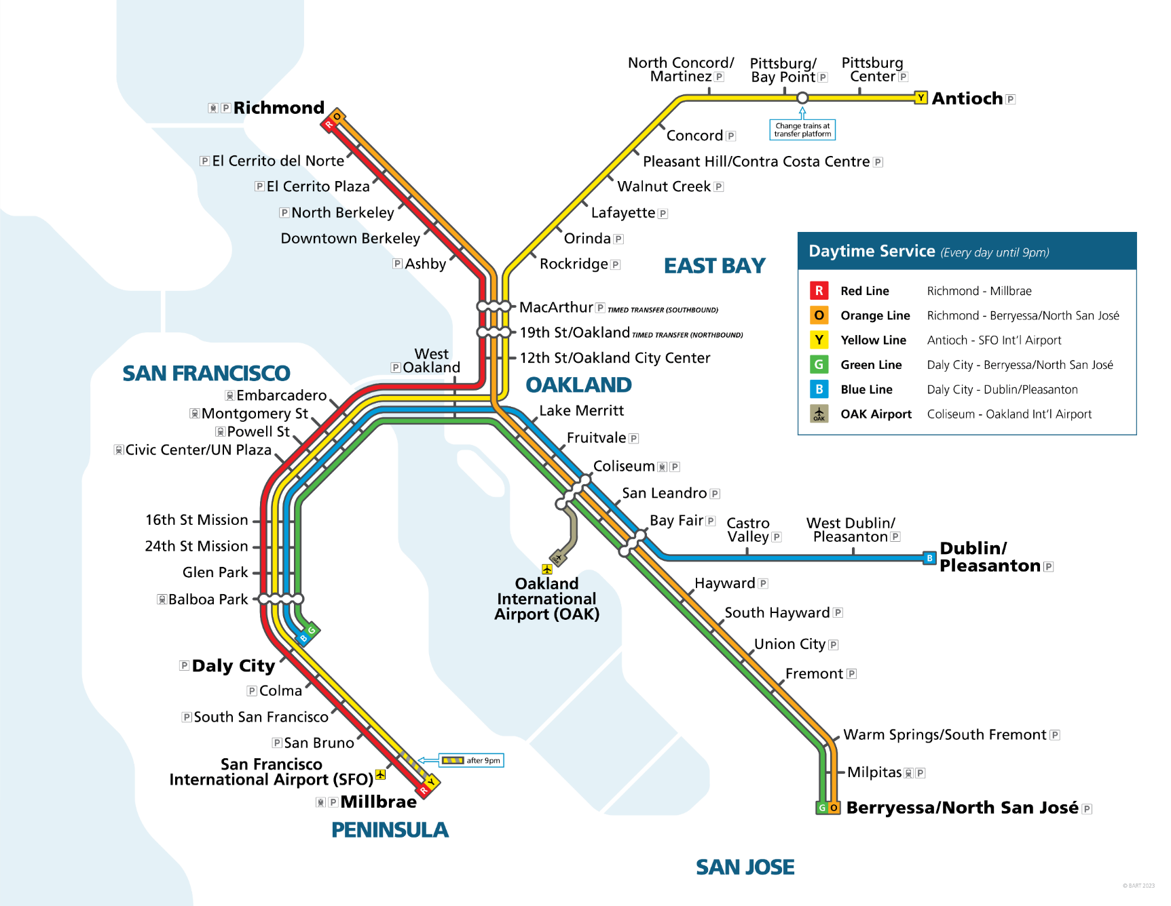
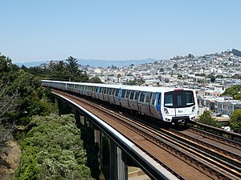
BART
VTA transfer on Rapid 500 to SJSU
Cheaper and more frequent than Caltrain, serves more of San Francisco
Service to SFO and OAK
Use Caltrain from South San Francisco, San Bruno, Millbrae

Slide 6
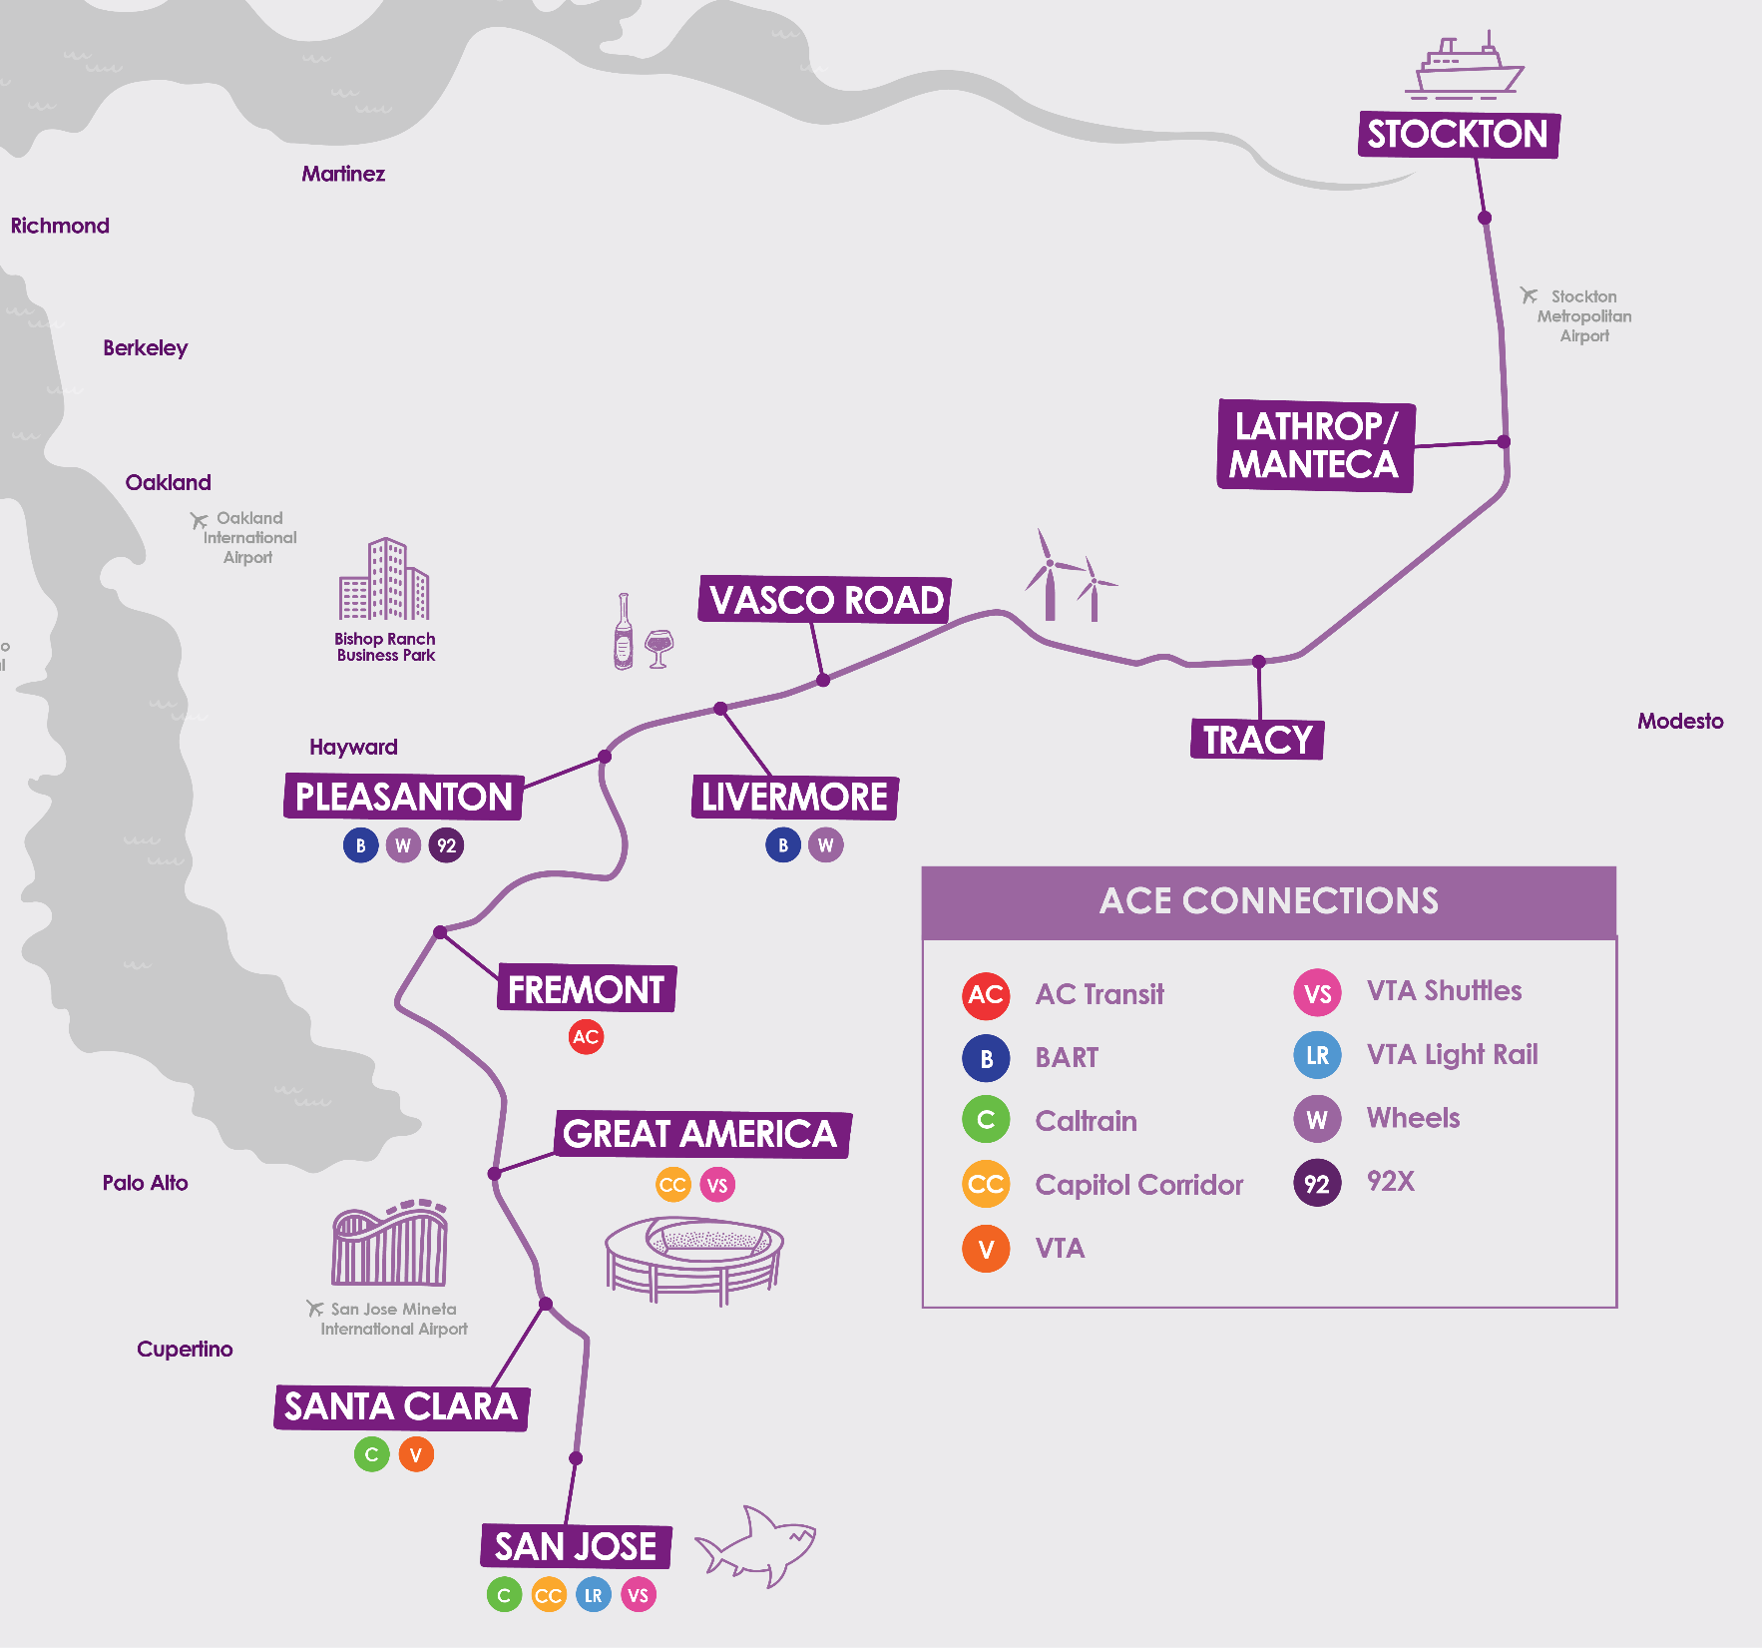
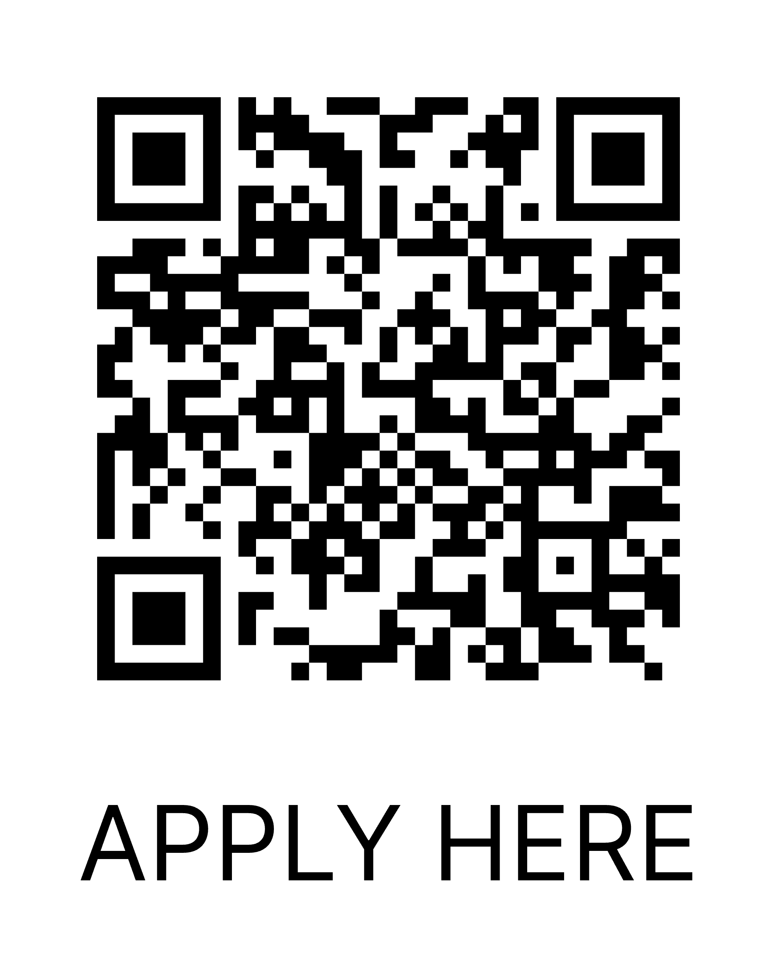
ACE
Free VTA transfers with ACE ticket
4 daily round trips between Stockton, Tri-Valley, and San Jose
50% off 20-ride and monthly passes for students and employees
Become an ACE College Student Ambassador for free roundtrip tickets, goodie package, & resume boost
bit.ly/acerailcollege

Slide 7
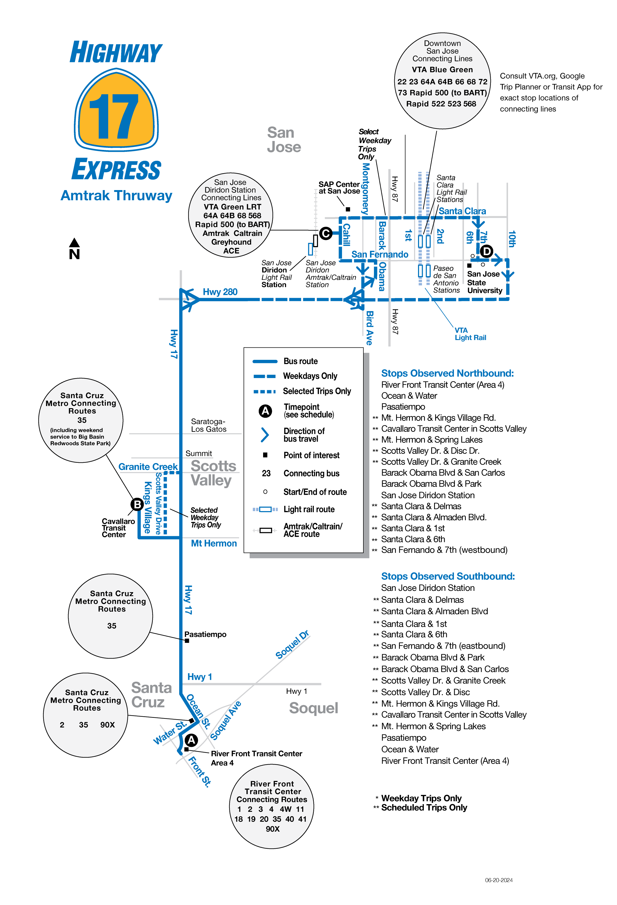
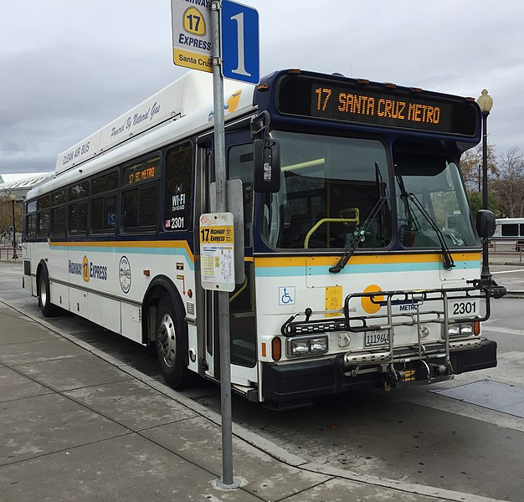
Highway 17 Express
VTA transfer on Rapid 500 to SJSU
10% discount on 15 ride bundles and monthly passes
Not all trips serve Scott’s Valley or SJSU, check schedule

Slide 8
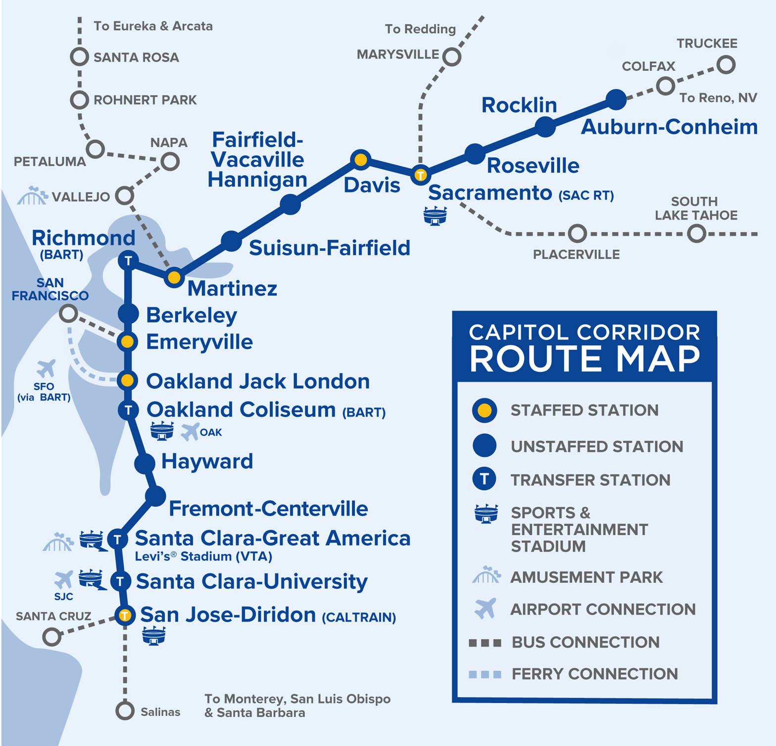
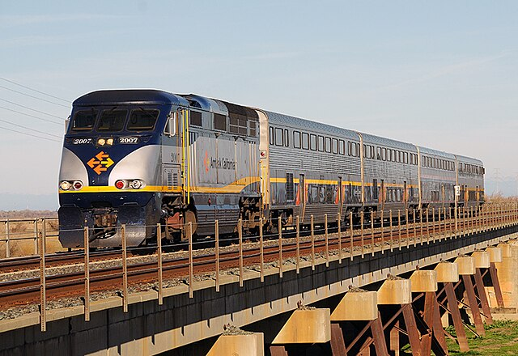
Capitol Corridor
VTA transfer on Rapid 500 to SJSU
Service from Sacramento area to San Jose
15% Discount Under 25

Slide 9
Biking to SJSU
6 Enclosures on Campus
Protect your bike
Use a U-Lock

Slide 10
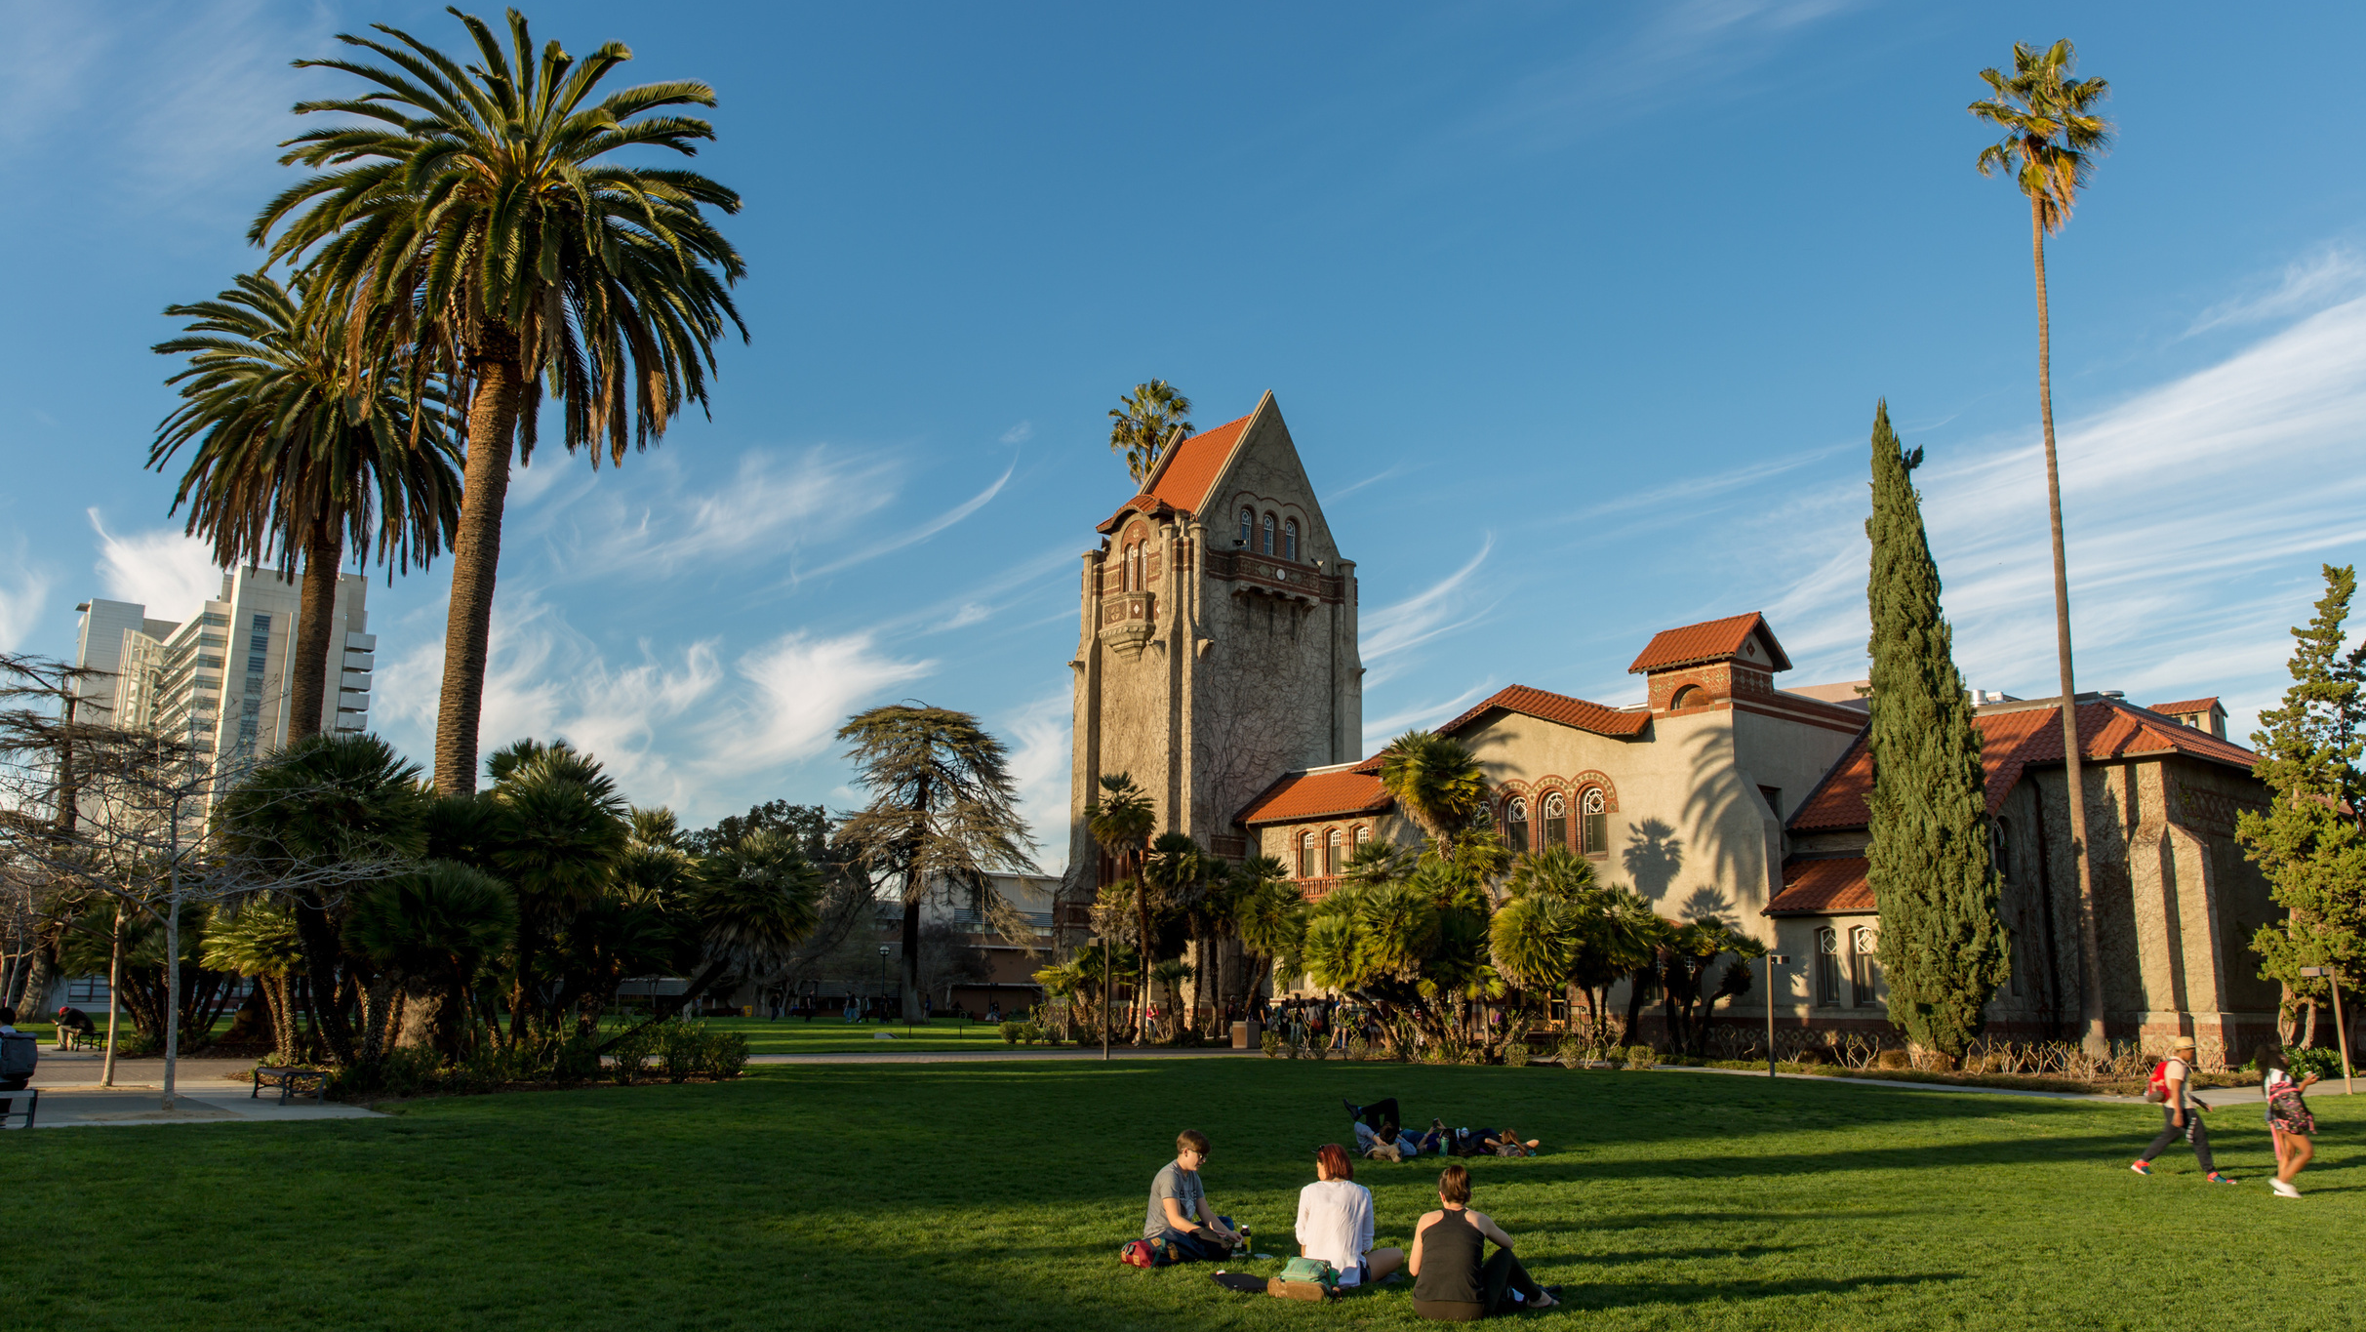
Additional Resources
BayWheels Bike Share -Short Term Bike Rentals
Zipcar-Short term on campus car rentals
Transit App- Trip Planning with real time departures/arrivals

Slide 11
Contact Us!
Student Union, East Wing Room 1800
Phone: (408) 924-7433
Email: transportation@sjsu.edu
Website: ts.sjsu.edu

